Slide 1
Accounts Payable I

Slide 2
Contents
Overview
Purpose
Uses
Challenges
GL and Subsidiary Ledger
Vendor Account Group
Vendor Master Data
Notes:
Explain the lesson coverage

Slide 3
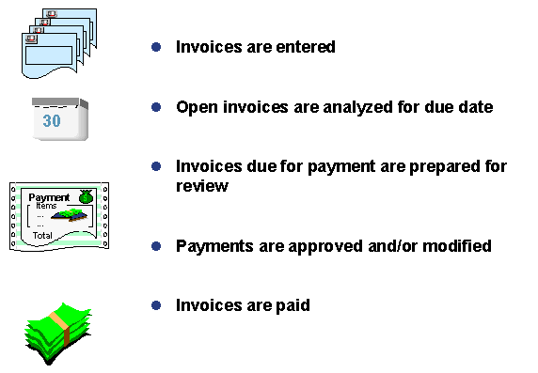
Accounts Payable Overview
Invoice are
entered
in FI
Open items
are analyzed
for due date
Payment Made
to Vendors
Notes:
This In-house course was developed to meet the needs of SAP R/3 Consultants working at Capgemini. This course is designed to present a high level view of Account Payable Overview and to provide the Consultants with basic information about how to use this Functionality.
More in-depth courses have been developed to train Consultants in specific areas discussed during this course.
Your comments at the conclusion of this training session are appreciated and will help us better tailor future courses to meet your training needs.

Slide 4
Purpose
The Accounts Payable application component records and manages accounting data for all vendors. It is also an integral part of the purchasing system: Deliveries and invoices are managed according to vendors
The purpose of accounts payable system is to make the payment to their vendors timely manner
It is important that the information on purchasing documents is complete and correct, in order to ensure that the payments made on the AP documents can be processed efficiently and accurately

Slide 5
Use
The Accounts Payable application component records and administers accounting data for all vendors
The system automatically makes postings in response to the operative transactions
Payables are paid with the payment program. The payment program supports all standard methods, also covers country-specific methods
Postings made in Account Payable are simultaneously recorded in GL where different G/L accounts are updated based on the transaction involved. The system contains due date forecasts and other standard reports that you can to help you monitor open items

Slide 6
Challenges
Business Challenge:
The Accounts payable process, mainly the payment process in SAP should be compatible with all systems, methods used to make payments like EDI, wire transfer etc.
Should be able to make timely payment to the suppliers
The accounts payable function provides an opportunity to improve business performance. Close management of the accounts payable function can have a direct impact on an enterprise’s cash flow and on vendor satisfaction and supply chain functioning
Account payable system make sure that payment should be in due date and there by achieving cash flow and fund flow optimization
Each and every business transaction to be tracked and recorded as per accounting principle

Slide 7
GL and Subsidiary Ledger
When you post items to a subsidiary ledger, the system automatically posts the same data to the general ledger.
Data Updated
Data Entered
Recon A/C
General Ledger
Subsidiary Ledger
Notes:
When you post items to a subsidiary ledger, the SAP system automatically posts the same data to the general ledger at the same time. Each subsidiary ledger has one or more reconciliation accounts in the general ledger. These reconciliation accounts ensure that the balance of G/L accounts is always zero. This means that you can draw up financial statements at any time without having to transfer totals from the subledgers to the general ledger.

Slide 8
Vendor Account Group
Status
The status of the fields in the master record
Whether the account is for one – time vendors or General vendors
Which fields in the Vendor master should be optional, required, display or suppressed
The number range of the accounts
Vendor
Account Group
C
O
N
T
R
O
L
S
Partner Schema
Field Selection
Number Range

Slide 9
Vendor Account Group
When you create vendor master records, enter the account group on the initial screen. In Financial Accounting, once the vendor account has been created, you can no longer change the account group
There are separate number ranges for customer and vendor accounts. The range of possible account numbers is divided into smaller number ranges
Number ranges must not overlap

Slide 10
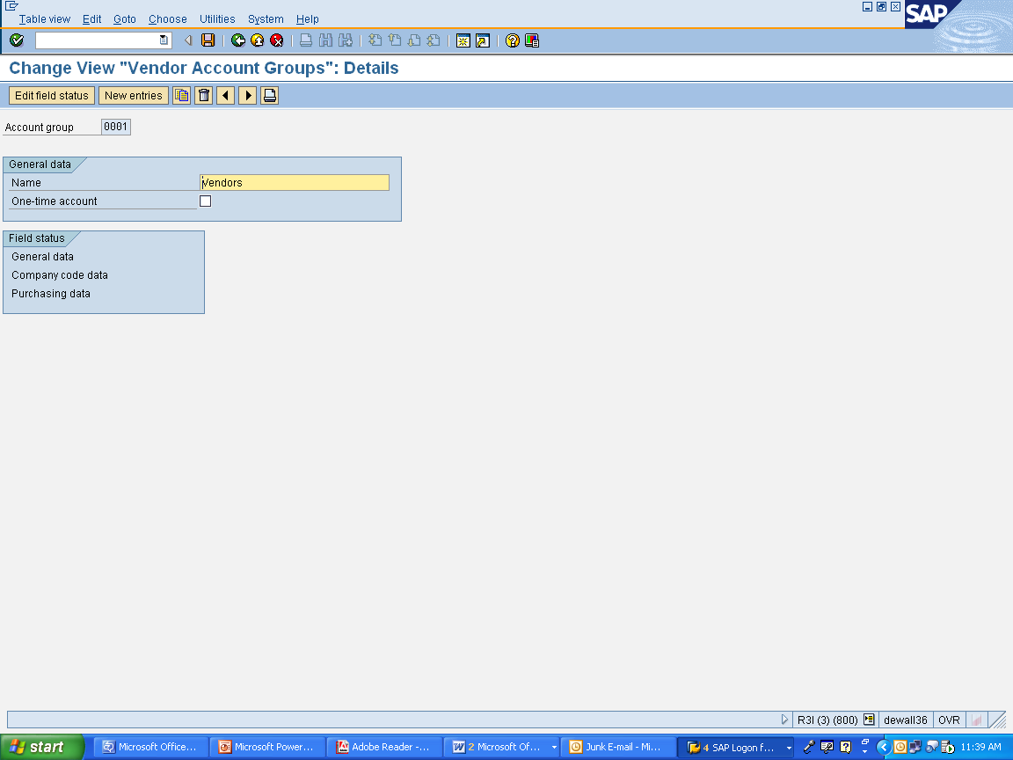
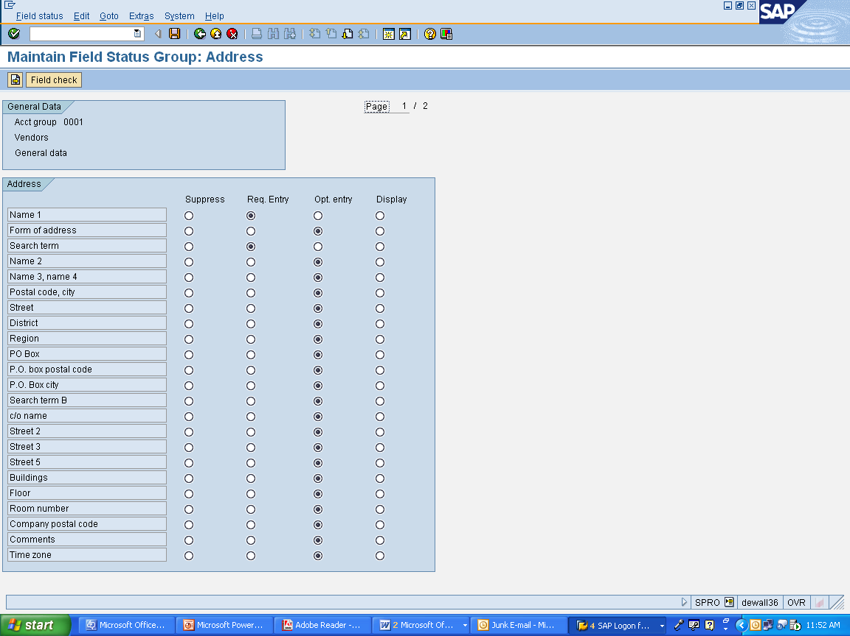
Vendor Account Groups
When creating vendor master records, the account group is entered on the initial create screen.
Field Group Status
Initial Create Screen

Slide 11
Vendor Account Group
Vendor or one-time vendor status
Field selection
Account group determines...
Type of number
assignment
Number
assignment interval
An account group defines the control functions for vendor master record maintenance
Every vendor master is managed under an account group
Notes:
one-time vendor is a vendor with whom you do business only once or rarely.
Therefore you create a common master record for all of these vendors, which does not, however, contain data specific to one single vendor, such as name and address.

Slide 12
Number Range for Vendors
When you define an vendor account group, you also determine the number interval in which the accounts of this group must lie. Field status groups are independent of company code
For each number range you can define whether the number assignment is internal or external. Internal numbers are assigned by the system, whereas external numbers are entered by the user who creates the record. External numbers maybe alphanumeric
With internal number assignment, the system always assigns the next number available in the range to a new account. If you want to know how many numbers are left in a specific number range, you can display the Current Number
With external number assignment, the user chooses the account number. Numbers do not have to be assigned in sequence; therefore, a current number cannot be displayed
Each number range can be assigned to one or more account groups

Slide 13
Normal Account or One-Time Account
For all vendors with whom you rarely do business, create a special vendor master record. These master records contains payables for one-time vendors (one-time accounts). In contrast to other master records, a one-time account master record does not contain any information about a specific vendor since this account is used for more than one vendor. Therefore, the vendor- specific fields should be hidden
You enter the vendor-specific data for one-time vendors in the document during posting

Slide 14
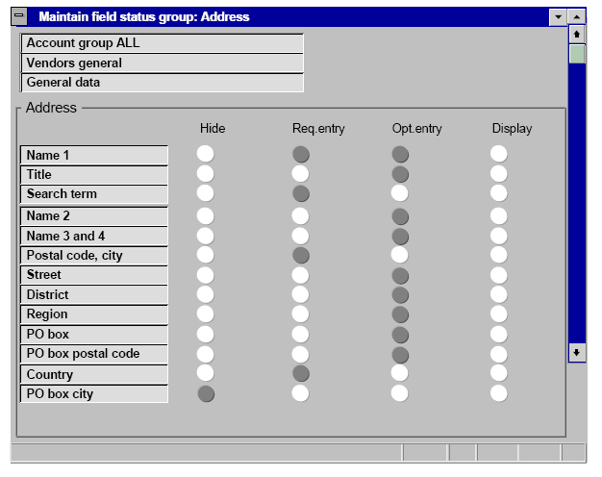
Screen Layout for Vendor Master Records
Field Status Selection:
Field is ready for input (Optional field)
Field must be filled (Required field)
Field is displayed only (Display field)
Field is hidden
Notes:
The account group determines the status of the fields in a vendor master record. You have to specify an account group when creating a master record.
When you enter a vendor master record, you must makes an entry in some of the fields.

Slide 15
Controlling the Field Status
The layout of customer/vendor master data screens can be affected by several factors:
Account group-specific control: Usually, the field status is controlled only by the account group. This means that all accounts of one account group have the same screen layout
Transaction-specific control: The field status can be dependent on the master data transaction ("Create", "Change" or "Display"). The transaction-dependent field status should be set to “display” for the “change” transaction if the field is not to be changed after it has been created, such as the “reconciliation account” field, for example
Company code-specific control: You can control the field status for fields in the company code segment of vendor master records via the company code-specific screen layout. You can hide fields that are not used in a specific company code, but enter values in these fields in other company codes

Slide 16
Vendor Master Data
The vendor master includes all data necessary for processing business transactions and corresponding with vendors
Information is shared between the accounting and purchasing departments
Data is maintained in the following views of vendor master:
General data
Company code data
Purchasing data
Vendor Master Data
General data
Company code data
Purchasing Org data

Slide 17
Business Partner Vendor
In S/4 HANA, the customers and vendors transactions have been merged in the same transaction BP, Business Partner
In SAP S/4HANA, Business Partner is the leading object and single point of entry to maintain Business Partner, Customer, and Supplier (formerly known as Vendor) master data
A Business Partner can be a person, organization, group of people, or a group of organizations, in which a company has a business interest. It is the single point of entry to create, edit, and display the master data for business partners, customers and vendors. A Business Partner consists of general data like name, address, bank information, etc. as well as role specific information i.e. customer/vendor/employee data
Compared to classical ERP transactions, maintenance of Customer and Supplier master data via Business Partner has many advantages
Data Redundancy: A person can be a Vendor as well as customer, in traditional ERP we have to create two objects. With business partner single object is only required
Multiple Transactions: To create vendor or customer we have to go to different transactions. With Business Partner single transaction “BP” is required both objects
Business Partner is now capable of centrally managing master data for business partners, customers, and suppliers. With current development, BP is the single point of entry to create, edit, and display master data for business partners, customers, and suppliers

Slide 18
Vendor Master Data
Vendor Master Views
Validity
General Data Address
Communication
Valid
for all organizations
Company Code Data Bank Data
Payment Transactions
Account Management
Valid for one company code
Purchase Org Data Bank Data
Payment Transactions
Account Management
Valid for one purchasing org
Notes:
Data is grouped into three categories:
General data
Company code data
Purchasing data

Slide 19
Pages of the Vendor Account
Important fields are:
Search Terms: You can enter an abbreviation for the customer/vendor name in these fields. The format is defined by company guidelines and practices
Corporate Group: Customers or vendors who belong to one corporate group can be grouped together by a user-defined group key. This group key can be used for running reports, transaction processing, or for match codes
Accounting Clerk: The name of the accounting clerk must be saved under an ID. You can enter this code in the customer/master records for which the clerk concerned is responsible. The name of the clerk is then printed on correspondence automatically. You can also use this ID for sorting dunning and payment proposal lists

Slide 20
Pages of the Vendor Account
Line item display and open item management are configured as standard for every customer/vendor account
You can also create new vendor master records with reference to an existing master record
The IBAN (International Bank Account Number) is an internationally recognized, unique identification number for a certain bank account. IBANs were designed by the ISO (International Organization for Standardization) and ECBS (European Committee for Banking Standards) to facilitate handling of international payment transactions
You can enter an IBAN as part of the bank details for vendor master data, and in the Customizing settings for your house bank. The IBAN can only be entered in a vendor master record if the business partner provides his or her IBAN and requests the entry

Slide 21
Vendor Master Data
Vendor Master
Data Creation
Create
Change
Display
Block /
Unblock
Mark for
Deletion
Notes:
CREATE:
1.Create separately for the company code
2.Create separately for the purchasing area
3.Create centrally for both company code and purchasing area
CHANGE:
Change data centrally (general, company code, and purchasing data)
Change accounting data only (general and company code data)
Change purchasing data (general and purchasing data)
DISPLAY
You can display all the changes for the following:
A certain field
A master record
For several vendor master records
BLOCK
Posting block for certain company codes OR for all company codes.
Purchasing block for certain purchasing organizations or for all purchasing organizations.

Slide 22
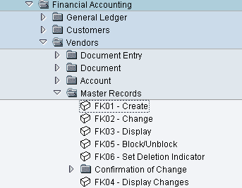
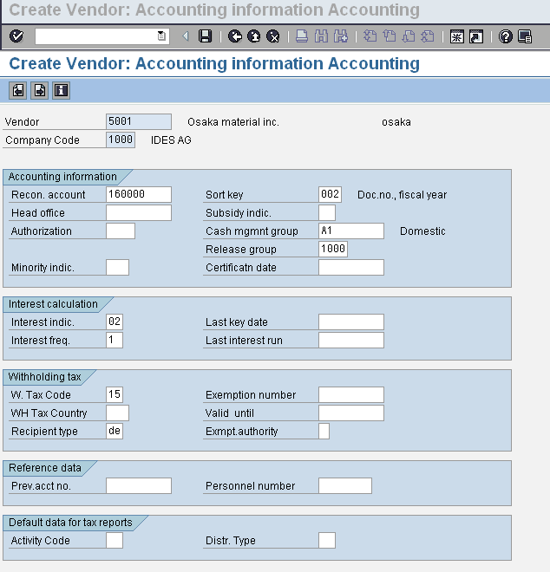
Vendor Master Data
Vendor Creation
T Code
Notes:
The vendor master includes all data necessary for processing business transactions and corresponding with vendors.
Information is shared between the accounting and purchasing departments.
Data is grouped into three categories:
General data
Company code data
Purchasing data

Slide 23
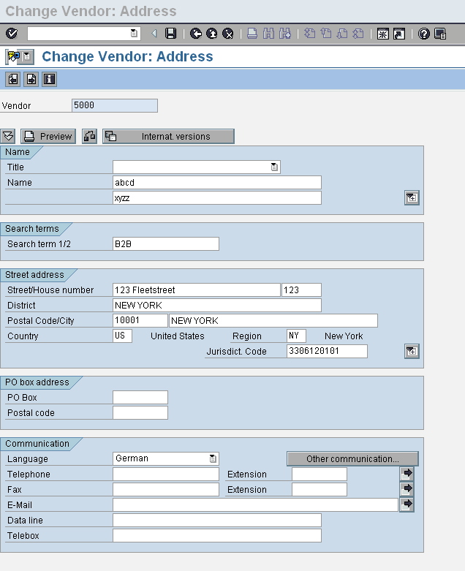
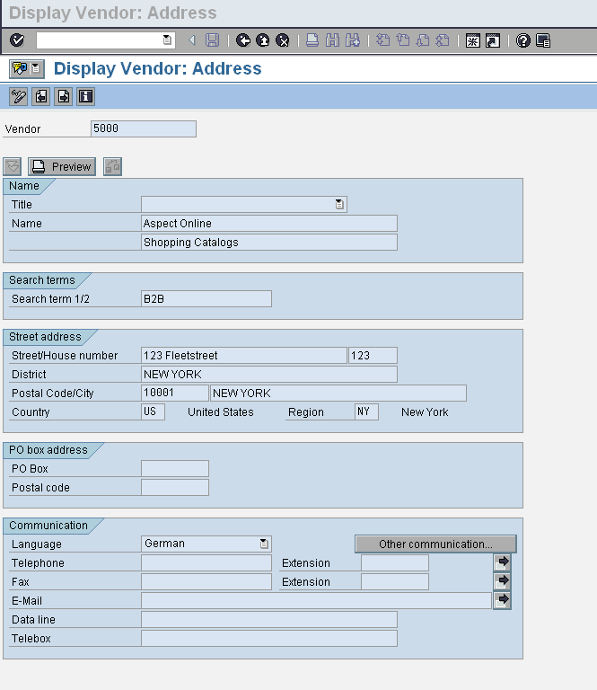
Vendor Master Data
Change/ Display

Slide 24
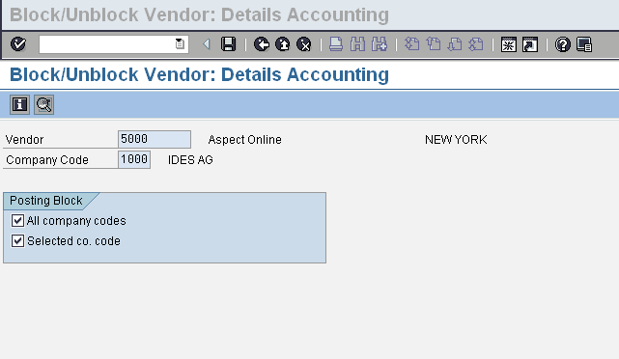
Vendor Master Data: Blocking Vendor
Posting Blocked

Slide 25
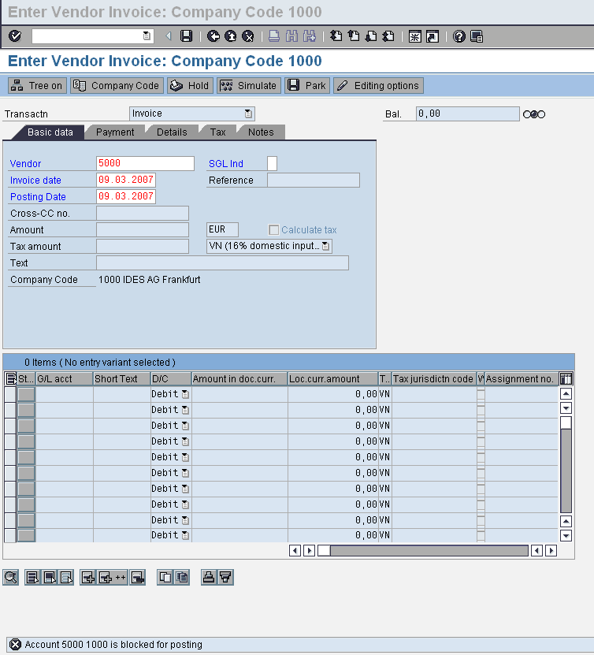
Vendor Master Data: Posting Blocked
Message Displayed
Posting Blocked
Notes:
In the previous screen I have blocked company code 1000 and vendor 5000, when I tried to post document in vendor 5000 , it says “ Account 5000 1000 is blocked for posting” You can see the message.

Slide 26
Vendor attributes that sufficiently differentiate them by their:
Address
Control
Payment Transactions
Accounting Information
Correspondence
Purchasing Data
Partner Functions
Vendor Master Data – Typical Screen

Slide 27
Vendor Master - General Data – Address
Name: Name of the vendor
Search Term: A method to find your vendor by match-codes
Street: Optional entry
City: Mandatory entry
Postal Code: Mandatory entry
Country: Mandatory entry
Communication
Language key Mandatory entry: This is the language the vendor uses. All communications to them will be in this language
Notes:
Address has typical demographic information
Control has tax and accounting information – Payment
Payment Transactions – Who makes the payments (bank or alternative payor)
Correspondence – Who and how to contact the people in the purchasing Org
Purchasing Data – Who is the sales person, What conditions, terms, Inocterms (International Chamber of Commerce shipping)
Dunning works on this side
Partner functions – Defines who is responsible for what action.

Slide 28
Vendor Master - General Data – Control Data
Account Control
Customer (if the vendor is both a vendor and a customer)
Tax Information
VAT Registration Number: Number, with which the customer reports to the tax authorities

Slide 29
Vendor Master - General Data – Payment Transactions
Bank Details
Bank Key: Selected from a match code with company code entered
Bank Account
Account Holder
Partner Bank Type (if vendor has more than one bank account, then it allows to sequence those accounts)
Payment Transactions
Alternative Payee: Used to enter another vendor number
Instruction Key: To control which statements are given to the banks during the payment order
Notes:
Bank Key
When you define the country key, you also specify the country-specific definition of the bank key.
Normally, you manage banks using their bank number. The bank number in the control data for the bank is then displayed twice, that is, as the bank key too.
In certain countries, the bank account number takes on this function; then there are no bank numbers and the bank data is managed using the account number.
For data medium exchange, you may find it useful to be able to enter foreign business partners without a bank number, even if there are bank numbers in the country in question. In this case,
the bank key can be assigned internally.
Instruction key for data medium exchange
For automatic payment transactions, this field (along with the house bank country and the payment method determined by the payment program) controls which statements are given to the participating banks when carrying out the payment order. This field is used in countries such as Germany, Austria, the Netherlands, Spain, Norway, Finland, and Japan as well as for the internnational SWIFT format, MT100.

Slide 30
Vendor Master – Accounting Information
Reconciliation Account
An individual G/L account recorded in line-item detail in the sub-ledger and summarized in the G/L
The information entered into the reconciliation account is all line-item data from the vendor account
The reconciliation in the G/L is at the summary level and is used to reconcile against the vendor account at the total level, while the sub-ledger identifies line-item data
Postings to sub-ledgers (such as accounts receivable or accounts payable) are automatically concurrently posted to the corresponding reconciliation account in the General Ledger
Thus, the General Ledger is automatically updated and remains in balance with the customer and vendor individual account totals
Sort Key
Used to select a sort for the allocation field

Slide 31
Vendor Master – Payment Transactions
Payment Data
Payment Terms (cash discounts and favorable payment periods offered by vendor)
Tolerance Group (the limit to which an event can deviate)
Check Double Invoice (to check for double or duplicate invoices when they are entered)
Check Cashing Time
Automatic Payment Transactions
Payment Methods
Alternate Payee
Payment Block(prevent any open items from being paid)
Grouping Key
Invoice Verification
Tolerance Group

Slide 32
Vendor Master – Correspondence Accounting
Dunning Data
Dunning Procedure: To remind vendors to deliver the material from the purchase orders
Dunning Block: If selected, the vendor is not for dunning run
Dunning Recipient
Date of Legal Dunning Procedure
Dunning Level
Dunning Clerk
Correspondence Information
Account Statement

Slide 33
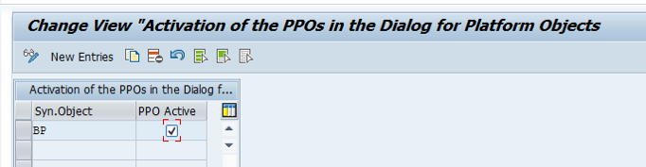
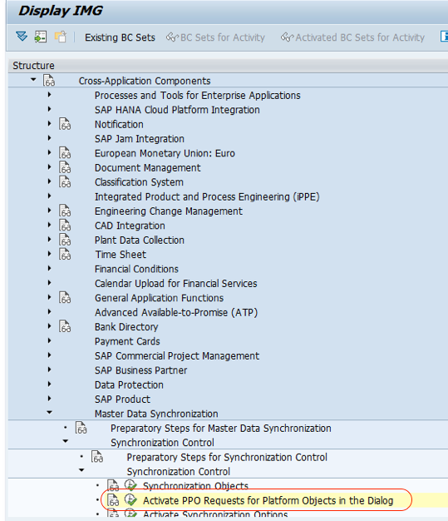
Business Partner Customizing
Activation of PPO (Post Processing Active)
SPRO->IMG->Cross-Application Components–> Master Data Synchronization –> Synchronization Control–> Activate PPO Request for platform objects in the dialog
After this click on the check box.

Slide 34
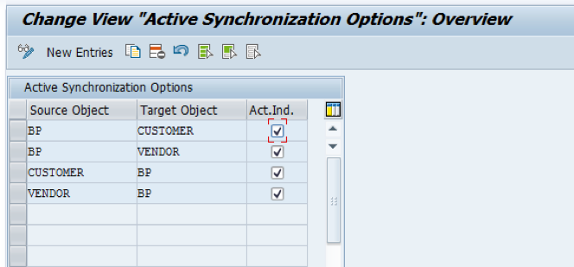
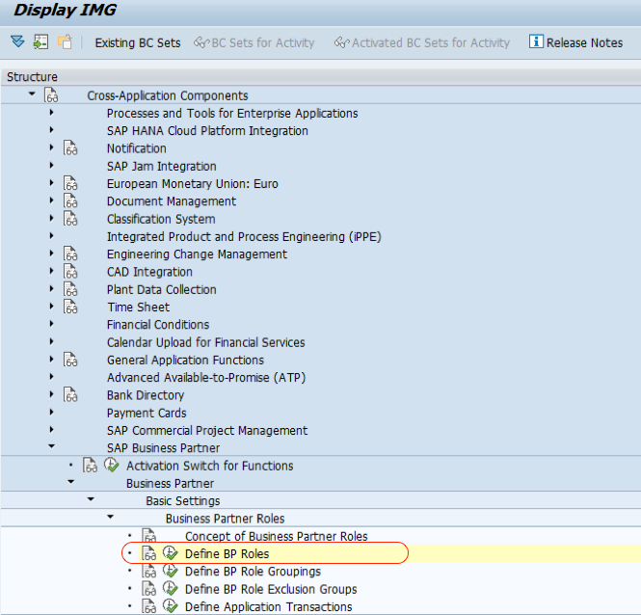
Activate synchronization between Business Partner and Customer / Vendor
SPRO->IMG->Cross-Application Components–> Master Data Synchronization –> Synchronization Control–> Activate Synchronization Options
Define BP Roles
SPRO->IMG->Cross-Application Components–> SAP Business Partner–>Business Partner–> Basic Settings –> Business Partner Roles–> Define BP Roles

Slide 35
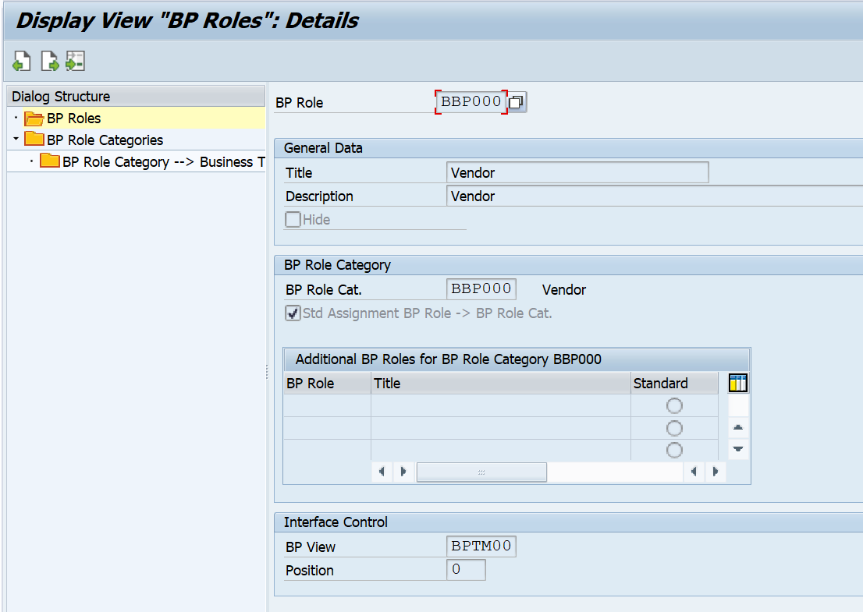
BP Role
Maintain Data for Business Roles and SAVE
Notes:
CREATE:
1.Create separately for the company code
2.Create separately for the purchasing area
3.Create centrally for both company code and purchasing area
CHANGE:
Change data centrally (general, company code, and purchasing data)
Change accounting data only (general and company code data)
Change purchasing data (general and purchasing data)
DISPLAY
You can display all the changes for the following:
A certain field
A master record
For several vendor master records
BLOCK
Posting block for certain company codes OR for all company codes.
Purchasing block for certain purchasing organizations or for all purchasing organizations.

Slide 36
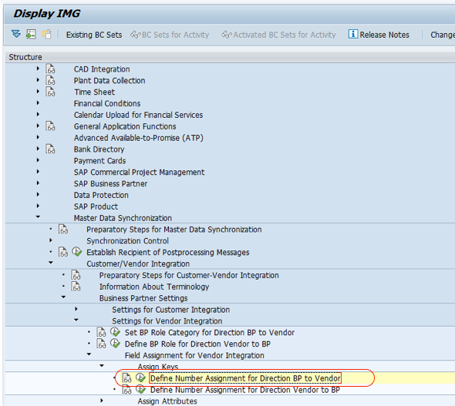
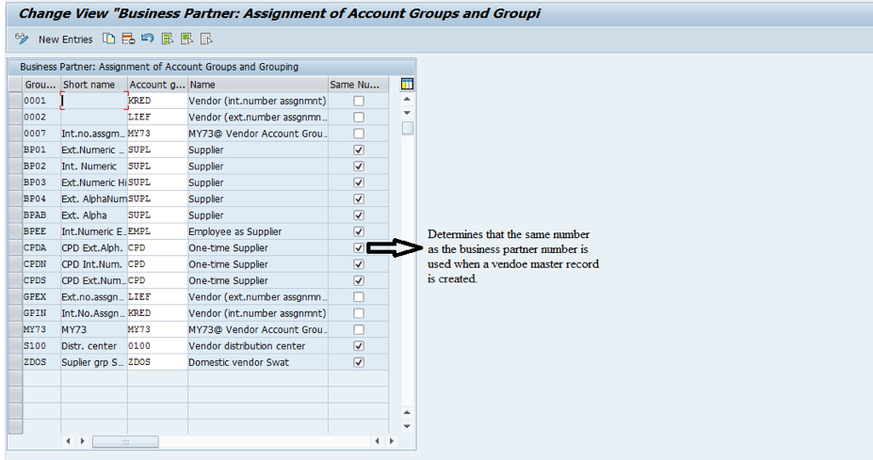
Define Number Assignment for Direction BP to Vendor / Customer
Maintain and select the check box if you want the Business Partner number and Vendor number to be same
SPRO->IMG->Cross-Application Components–> Master Data Synchronization–>Customer/Vendor Integration –> Business Partner Settings –> Settings for Vendor Integration –> Field Assignment for Vendor Integration–> Assign Keys
Notes:
The vendor master includes all data necessary for processing business transactions and corresponding with vendors.
Information is shared between the accounting and purchasing departments.
Data is grouped into three categories:
General data
Company code data
Purchasing data

Slide 37
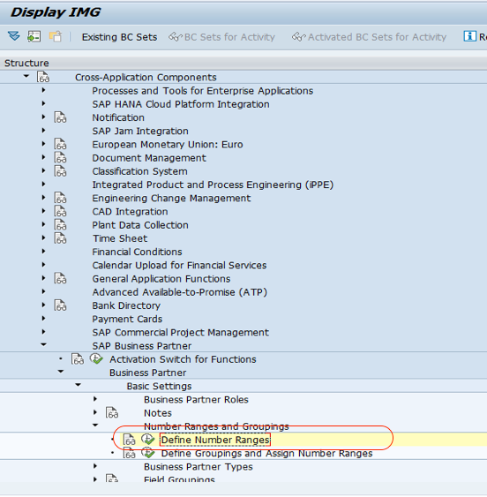
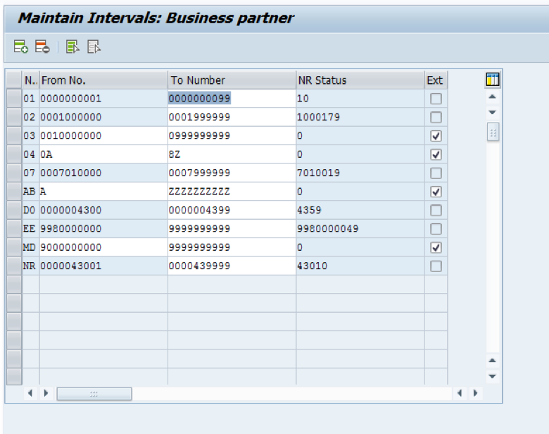
Define BP Number Range and assigning to BP Grouping
Cross-Application Components–> SAP Business Partner–> Business Partner–> Basic Settings –>Number Ranges and Groupings

Slide 38
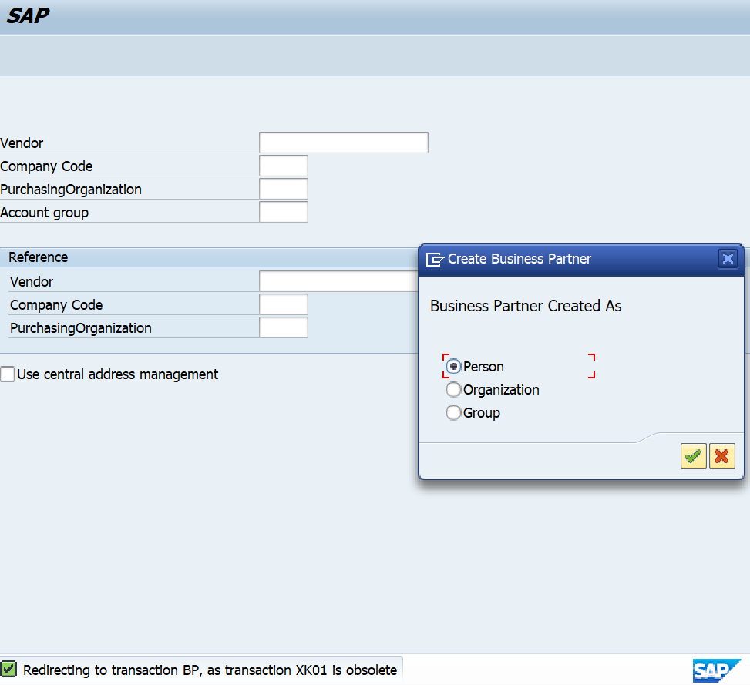
Vendor Master Data
In S4 HANA when you enter T code XK01 it will redirect to BP transaction, a prompt will come that will ask you to choose Person, Organization and Group.

Slide 39
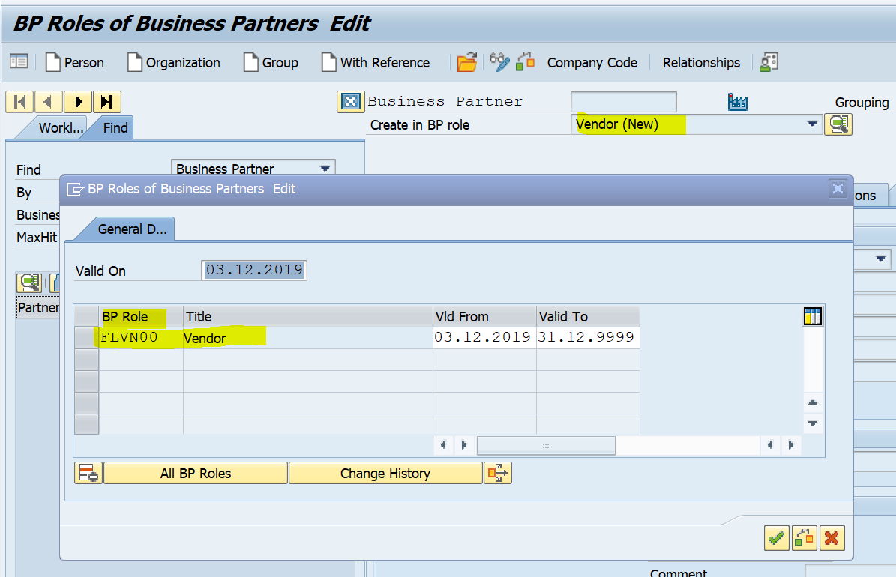
Vendor Master Data: BP
Here you can see that default BP Role is FLVN00 (FI Vendor)
Notes:
In the previous screen I have blocked company code 1000 and vendor 5000, when I tried to post document in vendor 5000 , it says “ Account 5000 1000 is blocked for posting” You can see the message.

Slide 40
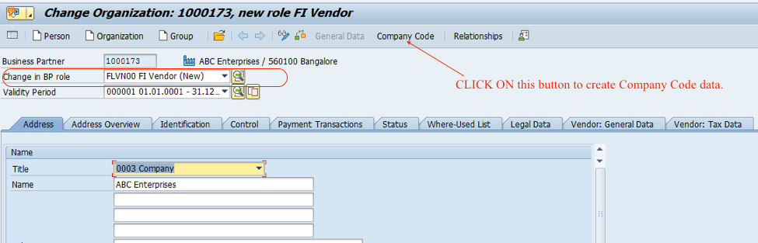
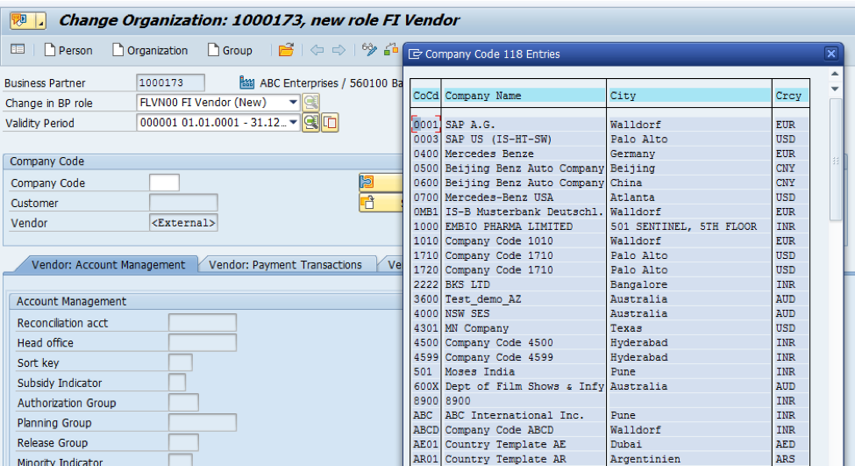
Vendor Master Data: BP
To create FI Vendor, we can extend the Business Partner already created with Role FLVN00 (FI Vendor). The role can be selected from dropdown

Slide 41
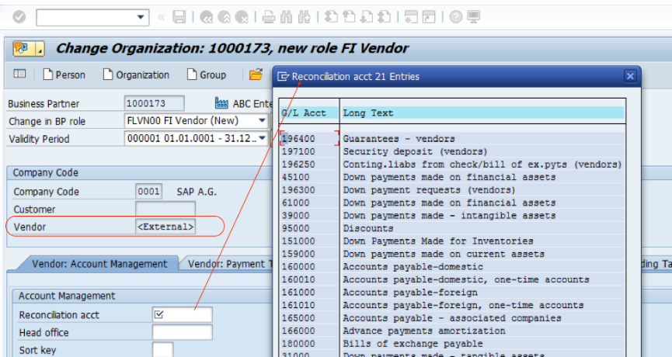
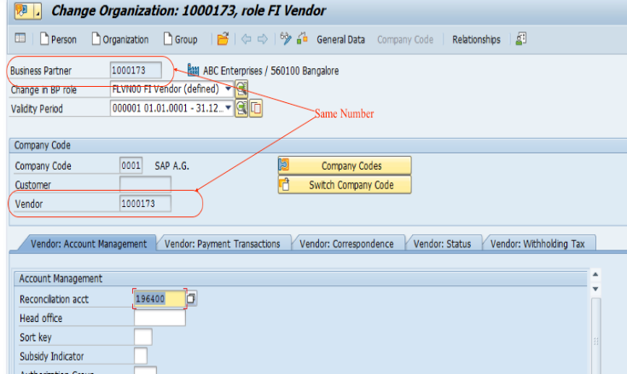
Vendor Master Data: BP
After selecting Company code press Enter and then fill the Recon account and other mandatory fields.
But after saving Vendor number will come same as BP number.
Notes:
Address has typical demographic information
Control has tax and accounting information – Payment
Payment Transactions – Who makes the payments (bank or alternative payor)
Correspondence – Who and how to contact the people in the purchasing Org
Purchasing Data – Who is the sales person, What conditions, terms, Inocterms (International Chamber of Commerce shipping)
Dunning works on this side
Partner functions – Defines who is responsible for what action.

Slide 42
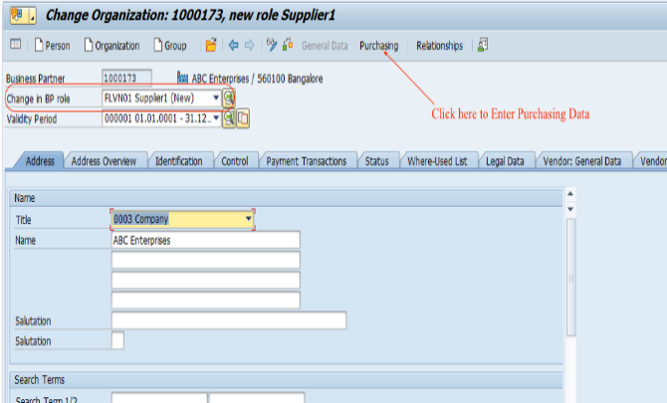
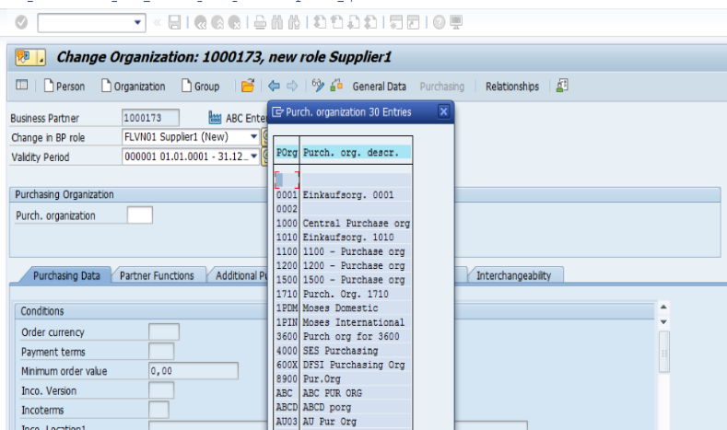
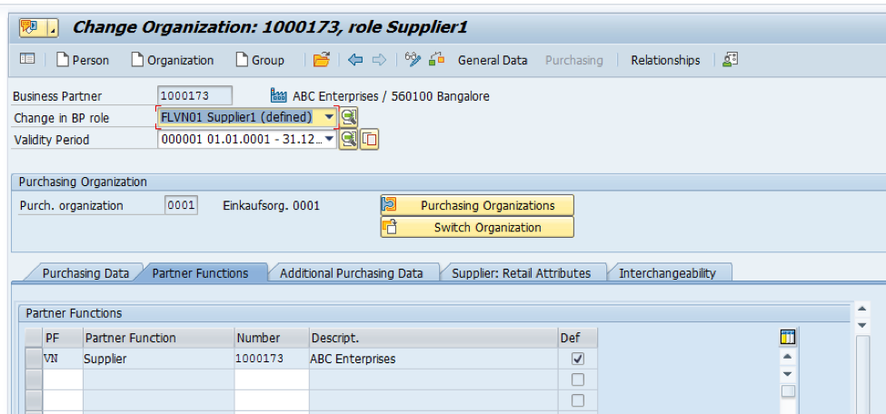
Vendor Master Data : BP
Extending Vendor to Purchasing Data, select Role FLVN01 from dropdown
Select Purchasing Data and then choose Purchasing Org and press enter
Enter all the mandatory fields

Slide 43
Vendor Master – BP – Payment Transactions
Payment Transaction (Bank Details)
Bank Key: Selected from a match code with company code entered
Bank Account
Account Holder
Vendor: General Data (Payment Transactions)
Alternative Payee used to enter another vendor number
Instruction Key: To control which statements are given to the banks during the payment order
Notes:
Bank Key
When you define the country key, you also specify the country-specific definition of the bank key.
Normally, you manage banks using their bank number. The bank number in the control data for the bank is then displayed twice, that is, as the bank key too.
In certain countries, the bank account number takes on this function; then there are no bank numbers and the bank data is managed using the account number.
For data medium exchange, you may find it useful to be able to enter foreign business partners without a bank number, even if there are bank numbers in the country in question. In this case,
the bank key can be assigned internally.
Instruction key for data medium exchange
For automatic payment transactions, this field (along with the house bank country and the payment method determined by the payment program) controls which statements are given to the participating banks when carrying out the payment order. This field is used in countries such as Germany, Austria, the Netherlands, Spain, Norway, Finland, and Japan as well as for the internnational SWIFT format, MT100.

Slide 44
Vendor – Accounting Information
Reconciliation Account
An individual G/L account recorded in line-item detail in the sub-ledger and summarized in the G/L
The information entered into the reconciliation account is all line-item data from the vendor account.
The reconciliation in the G/L is at the summary level and is used to reconcile against the vendor account at the total level, while the sub-ledger identifies line-item data.
Postings to sub-ledgers (such as accounts receivable or accounts payable) are automatically concurrently posted to the corresponding reconciliation account in the General Ledger
Thus, the General Ledger is automatically updated and remains in balance with the customer and vendor individual account totals
Sort Key
Used to select a sort for the allocation field

Slide 45
Vendor – Payment Transactions
Payment Data
Payment Terms (cash discounts and favorable payment periods offered by vendor)
Tolerance Group (the limit to which an event can deviate)
Check Double Invoice (to check for double or duplicate invoices when they are entered)
Check Cashing Time
Automatic Payment Transactions
Payment Methods
Alternate Payee
Payment Block(prevent any open items from being paid)
Grouping Key
Invoice Verification
Tolerance Group

Slide 46
Vendor Master – Correspondence Accounting
Dunning Data
Dunning Procedure: To remind vendors to deliver the material from the purchase orders
Dunning Block: If selected, the vendor is not for dunning run
Dunning Recipient
Date of Legal Dunning Procedure
Dunning Level
Dunning Clerk
Correspondence Information
Account Statement

